Slide 1
Big Mountain Resort Analysis
By Gavin Sadecki

Slide 2
How can the resort increase its revenue?
Big Mountain Resort recently build a new chair which increased operating costs by $1,540,000.
Big Mountain Resort believes their ticket price does not accurately reflect the amenities it offers to guests.
How can Big Mountain Resort determine a more accurate ticket price to help bring in revenue to offset the maintenance cost and capitalize further on its amenities?

Slide 3
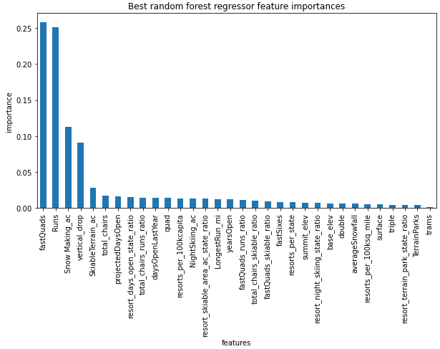
Recommendations and Findings
Our model found the most important features are the number of fast quads and runs the resort has.
Big Mountain Resort should change its ticket price to $95.84
They should also implement their second scenario they presented and increase ticket prices by an additional $8.61
Both of these changes will increase revenue by $41,037,500 per year on top of what the resort currently makes, assuming 350,000 visitors each staying for 5 days

Slide 4
The New Model
The resort’s previous model was to take the average ticket price of other resort’s and add a premium on top of it
We need a new way to assign a ticket price to the resort that reflects the amenities the resort has to offer
We tested two models, Linear Regression and Random Forest Regressor, both will be explained in the following slides

Slide 5
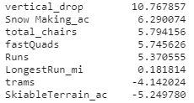
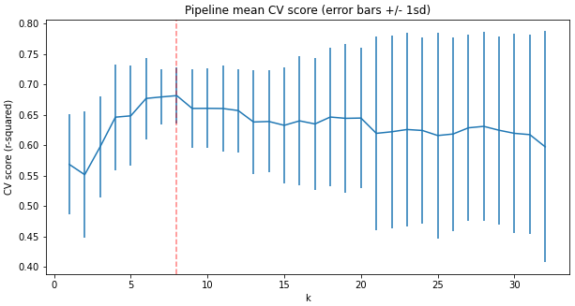
Linear Regression
Trained the linear regression model with cross validation of 5 folds, this gives us an idea of how well the model can train and predict our data
Tests were performed and determined the model works best when only focusing on 8 features
Linear regression gives us a mean absolute error of 10.50 with a standard deviation of 1.62
This tells us on predict price was wrong on average by about $10.50

Slide 6
Random Forest Regressor
Random Forest Regressor was also tested with cross validation of 5 folds
Looking at the important features given by RFR, we can see some overlap with the 8 best features from linear regression
RFR gave a mean absolute error of 9.64 and A standard deviation of 1.35
Due to a lower mean absolute error and lower standard deviation than linear regression, RFR was decided as the model to predict the ticket price

Slide 7
Conclusion
Using the Random Forest Regressor, we found that it performs better than our Linear Regression model
The RFR model suggests that the current ticket price should be set to $95.81, an increase of $14.81
Using the same model, we see that implementing the changes of the second scenario present to us will increase ticket prices by $8.61
These changes will increase yearly revenue by $25,917,500 and $15,067,500 respectively
The increase in revenue will be more than enough to cover the increase in operating costs of the new chair built and allow the company to pursue further ventures with the remaining amount

